Slide 1
Emerging Recruiting Trends That You Can’t Afford To Ignore 1-Page – May 6, 2016
40 actual v2
In order to be disruptive and to lead…
you must go first… and be bold
© Dr John Sullivan
Slides are available at www.drjohnsullivan.com
1

Slide 2
Dr Sullivan’s background
A recognized thought leader with 40 + years in HR
Former Chief Talent Officer of Agilent Technologies, the HP spinoff with 43,000 employees
Appeared on the CBS, ABC, PBS nightly news
He’s been quoted in the NY Times, HBR and the WSJ
A regular contributor to WSJ, ERE.net & LinkedIn
“The Michael Jordan of Recruiting” Fast Company Mag.
“The father of HR Metrics” Staffing.org
“One of the industries most respected strategists” SHRM
Selected among HR’s “Top 10 Leading Thinkers” BPI
Authored more than 900 articles and 10 books
Currently he is a Professor of Management @ SFSU
Advised over 200 firms on all 6 continents

Slide 3
Who am I? I’ve advised over 300 organizations
Apple Facebook Google Twitter Intel Microsoft Yahoo Nokia Dell Oracle HP
NIKE
Marriott
Pepsi
Starbucks
McDonald’s
GE
Johnson & Johnson
BMW
Sprint
E&Y
McKinsey

Slide 4
I have 3 simple goals for today
To encourage you to think about the direction and the speed in which recruiting is changing
To make you aware of the “next practices” that your most advanced TA competitors are already using (no surprises)
To convince you to track a few of the most relevant trends (i.e. track them with a Google alert)

Slide 5
4 reasons why you must track emerging trends
The speed of change in TA is approaching mobile phone speed (# of months of warning before disruption)
Sticking with “dated practices” can only produce weak results… because once everyone uses a recruiting tool, it loses its impact. And without Q of H data, you’re never know
It’s a competitive advantage to know what is coming, and tracking trends will help your firm stay ahead of your talent competitors
Knowing trends makes you appear “forward looking” to colleagues, executives and customers

Slide 6
Definition –What is an emerging trend?
It is…
A new and exciting “next practice” that has been successfully implemented at only 1% - 2% of the Fortune 500 firms
But because of its uniqueness, level of excitement and the impact that it creates…within the next two years… you can expect the top 20% of TA functions to implement it

Slide 7
In case you didn’t notice it…
The year 2015 was… The “1492” of recruiting
Because during that year…
the field of recruiting began the most radical change in its history… when it
finally “discovered”…
That we must use data to permanently replace
“I think” with… “I know”

Slide 8
Let’s start with an example…
Some people automatically reject emerging trends…
as unrealistic or “pie in the sky”

Slide 9
A trend or a dream? – Artificial intelligence in TA
AI / machine learning could someday replace humans… for selecting interview finalists…
Based not just on what they say, but how they say it during initial video interviews (analyzing phrasing, language, voice tone, physical gestures & pupil dilation)
You could then correlate assessments with Q of H data… to determine if the AI assessments accurately predicted performance on the job
You could also compare a manager’s hiring accuracy using their gut… vs. AI
Sound far-fetched?
HireVue found that evaluator accuracy ranges…
between 80% and (Fast Co.)
20%

Slide 10
Lesson to be learned
Keep constantly aware of trends…
Because given our accelerated rate of change,
they might not be as far off as you think!

Slide 11
We will now look at emerging TA trends… separated into 4 categories
Edgy trends borrowed from the business
Big picture trends that are harder to see
Traditional TA factors that are suddenly hot
No longer emerging… these are now dominant

Slide 12
Edgy trends borrowed from the business…
that are now seeping into TA
(This is also a trend)
Category 1

Slide 13
Trend #1
#1 – Shifting to data-based decision-making
Why:
Just reading the internet… shows that data-based decision-making has arrived in TA
The rest of the business has already shifted
Collecting TA metrics has produced no value… because we didn’t use them to make decisions
Google led the way with its analytics group and it’s R&D team
Data-based decisions are generally at least 25% better than “intuitive decisions” (also faster)

Slide 14
What does data-based decision-making look like?
Data reveals what predicts on-the-job performance
What selection factors?
What sources?
What interview questions?
Also
What single recruiting process factor has the highest impact?
For top performers, what selling points have the highest impact?
(learning ability)
(referrals, boomerangs)
(real problems)
(the hiring manager)
(the work, impact, coworkers)

Slide 15
An example of data-based decision-making
When is the best time to poach recent hires?
# of recent hire employees that quit
Anniversary date, 12 months at the firm
Action step – use it as a predictor!
Anniversary date at 24 months
Anniversary date at 36 months
Years at the firm
= Waiting period
Source: entelo.com using 1 million resumes

Slide 16
If I was a vendor… I would excel at these…
Can you prove to my CFO that your product works?
What will be my % of improvement in Q of Hire? (On-the-job performance, retention and diversity)
Did a split sample /control group prove it (with sales hires)
Have you sold it to an admired firm in TA (Google)
Tell me 5 things I need to know to land prospects
If you find people, does everyone have them? (competition / price)
What are the individual’s job attraction factors
The probability of them leaving? (or an alert/ anniversary date)
What is their current compensation?
What is their current zip code?
And one last thing
Are you the one-stop “answer guy” site? (with data)
Any questions?
Engage

Slide 17
Which is more accurate?
#2 - Algorithms vs. human judgment for screening
Why – “Computer algorithms do a better job evaluating a job applicant’s technical skills, personality, cognitive skills and overall fit for a job than a recruiting pro” (National Bureau of Economic Research) (Google)
MLB algorithms are the benchmark model
Only use algorithms that correlate with Q of H
Expect algorithms to eventually dominate in:
Sourcing actives
Resume screening (Online Channels Specialist @ Google)
Job matching candidates with jobs
Job / culture fit assessment

Slide 18
Trends borrowed from the business… that will become big in TA
#3 – Predictive analytics in recruiting
Why – alerts and trend lines give you time to prepare
Expect predictive analytics in these areas
The retention rate of new hires
The “career trajectory” of new hires
The “right time” to recruit (lower competition)
Predicting position vacancies (for replacements)
Talent opportunities, when targeted individuals might re-enter the job market
Workforce planning supply and demand

Slide 19
Trends borrowed from the business… that will become big in TA
#4 – Personalization / segmentation in recruiting
Why - customizing increases the impact/relevance of:
Expect personalization in these areas:
Recruitment messaging
Videos
Segmented web/SM pages (college)
Diversity recruiting (no lumping)
The jobs offered to exceptional candidates
Offers to meet their job acceptance criteria
Onboarding

Slide 20
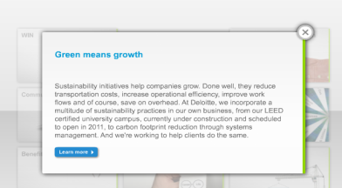
E-collateral Tool - Deloitte
The E-Collateral Tool
Helps recruiters connect
more deeply to candidates
by creating a custom Web
page for them based on
their unique interests and
career objectives. It’s a
simple, Web-based tool that
delivers a powerful message
about our values to
candidates.
“I had targeted a candidate and sent a couple of emails with no response,” said one recruiter. “I then created an eCollateral page for him and he responded almost immediately.”

Slide 21
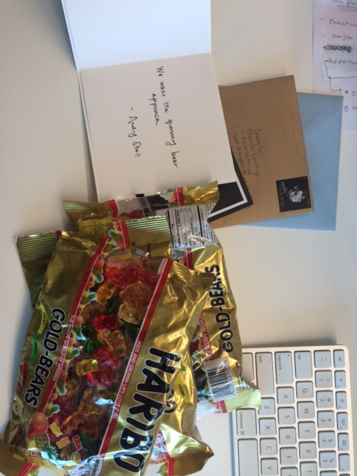
Example – Personalized recruiting
21

Slide 22
Trends borrowed from the business… that will become big in TA
#5 – Virtual Reality / 360° video
Why – it’s stunning, it’s more available, the WOW factor and it has a greater impact (General Mills)
Expect VR/360° video to be used in these areas:
Employer Branding messaging, especially college
Recruiting messaging
VR company tours and profiles on your webpage
Social media and YouTube
Candidate assessment with simulations
Recruiter / hiring manager training

Slide 23
Heat maps are widely used in business
Which state has the most hard to fill programmer jobs?

Slide 24
Trends borrowed from the business… that will become big in TA
# 6 - Heat maps help you visualize problems / opps.
Advantages of heat maps include:
Data-driven decision-making
They drive action for recruiters & hiring managers
They can be generated off an Excel spreadsheet
They can be used in many areas including:
The best sources for quality candidates / hires
The best teams for employee referrals
For assigning remote work to geographic areas where there is less competition

Slide 25
#7 – Additional “borrowed from business” trends
When should technology replace humans? – before hiring requisitions are approved, this will become an essential decision
QA can provide live recruiting answers -Question Answering (QA) is an artificial intelligence program designed to hold verbal and text conversations with potential recruits using what is known as a chatbot (U.S. Army)

Slide 26
#7 – Additional “borrowed from business” trends
Position prioritization – for high-impact and revenue generating jobs, assign quality recruiters & allow fewer vacancy days (MLB/NFL)
The business case for diversity – “Building an inclusive culture is now the #1 predictive strategy for global financial performance” (Bersin/Deloitte)
Consumer information for sourcing – using consumer information and “sales leads” to identify the most relevant (pay and location) prospects for critical jobs (FirstMerit)

Slide 27
#7 – More “borrowed from business” trends
Candidate research (from consumer research) - prospect/candidate/new hire surveys help you to fully understand key job search factors (Deloitte)
What top prospects look for in a job/firm
Where they would see branding information
How they find out about job openings
What triggers them to apply / accept

Slide 28
“Big picture trends” in recruiting
that only the most strategic will see
Category 2

Slide 29
5 “big picture trends” that are harder to see
Those involved in day-to-day operations may miss these trends
A major shift from having difficulty finding talent - to selling talent becoming the most important… but the weakest component in TA
Calculating business impacts becomes essential – executives expect a direct & measurable impact on corporate strategic goals and the qualification of those impacts in $’s (VW pollution engineer)

Slide 30
5 “big picture trends” that are harder to see
Being a TA consultant requires data to influence - “The best thing about using data to influence managers… is that it’s hard for them to contest it” (Google). Data and quantified business impacts begin to supersede “relationships” for influencing
A major shift in what we look for in new hires in the recruiting function – they now need business acumen & skills in finance, data, tech, social media, consulting and marketing
Conducting competitive analysis and providing a competitive advantage – providing both is now expected from executives because it’s “us against them” (give away / takeaway ratio)

Slide 31
These traditional TA elements have always been around
but some are now becoming hot
Category 3

Slide 32
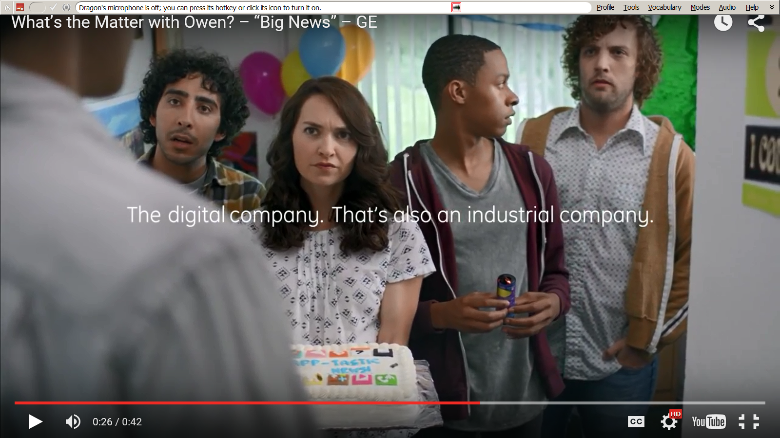
Have you seen this GE “Owen ad” on TV?

Slide 33
Not new – But they are becoming hot
#1 - TV Ads for Employer Brand building
Yes they are expensive but… what an impact
GE’s Owen TV ads “have increased the number of résumés we get by
Other firms that have used TV ads for employer branding include Walmart, Coors & Koch industries
eight times”

Slide 34
Example – Product commercials also build their employer brand
Coors TV commercial
“A story about loving what you do.”
“When you love your job, you never work a day in your life.”
“When beer is your calling, you never clock out.”
34

Slide 35
Not new – But they are becoming hot
#2 - Trends related to job descriptions
Video job descriptions – add excitement, “show the passion”, reveal the team/manager, plus they are authentic (Accenture, Deloitte)
Adding a marketing component to make them sell – conduct a blind side-by-side comparison to maximize their selling capability (Cisco)
Rewrite / restructure JD’s for impact/ diversity – eliminate biased words and structure (bullet points) so they are more diverse friendly. Then see if the revisions produce more apps (Textio/Google)
Twitter length JD’s – 140 character descriptions have to be compelling (FedEx & McD)

Slide 36
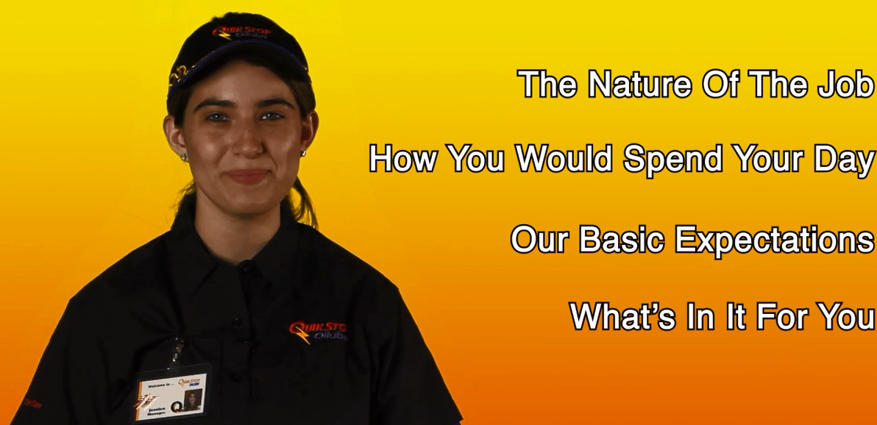
Example – Video descriptions can excite
Quickstop, Accenture and Deloitte use them
36

Slide 37
Example – Would this description be aggressive?
Searching for 2 F**king Great Developers – at Chatmeter ($115k - $140k / yr.) (San Diego)
If you're a great f**king developer who wants to make a bunch of money working somewhere awesome then keep reading.
We're a San Diego Tech Company (relocation covered for the right candidates) that's looking for not one but two awesome developers… This quarter you'll be adding kick ass new features to our already massively successful products…you'll be working on any number of projects like new products, internal tools, improving our already f**king great scalable architecture, or skunk works machine learning data analysis for new product R&D.
37

Slide 38
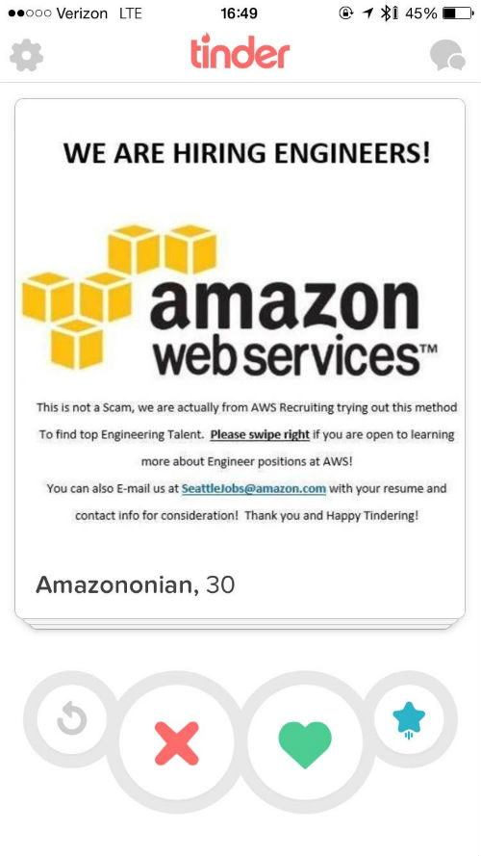
#3 – Aggressive means there are no more boundaries
Amazon puts job ads on Tinder
38

Slide 39
Raising the standard for aggressive recruiting videos
39

Slide 40
Not new – But they are becoming hot
#4 - Trends in candidate assessment
On-line assessment tied to Q of H (Footlocker)
Used data from an on-line applicant assessment tool to accurately select better interview slates
Results just from the pilot
Double digit increase in sales-per-hour
Double-digit reduction in staff turnover
Managers also reviewed fewer applicants, (Down from as many as 300 to as few as 3 per opening)

Slide 41
More trends
#5 - Using online contests / challenges to assess
Example - Snapchat's new digital platform allows firms to develop interactive challenges for screening potential candidates (Space150)
#6 - Blind/anonymous candidate assessment for diversity (Deloitte and Google)
Blackout elements on resumes that don’t predict
More telephone interviews
Questionnaire interviews
Text interviewing
Unconscious Bias Training (Google)

Slide 42
More trends
#7 - Find their work online – identifying sites where a prospects work is displayed (Pinterest, GitHub) and encouraging employees to make referrals from them
#8 - Accepting online LinkedIn profiles in lieu of resumes – unlike resumes, profiles…
Are less likely to require updating
Make candidate/prospects easy to compare
Are more accurate

Slide 43
These are definitely hot… but few do them well
Quality of Hire (on-the-job performance/retention)
Talent pipelines for upcoming openings
Remote college recruiting
Workforce and succession planning
Calculating the exponential value of innovators / top performers (Google)
Countering negative social media messages
The TA Moneyball!

Slide 44
No longer emerging…these trends are now dominant
so they can no longer be avoided
Category 4

Slide 45
These are now mainstream practices
Referrals remain king – a focus on quality over volume, proactive referrals, pipeline referrals, assigned referrals, aim for over 50% of all hires
Mobile phone recruiting – over 43% use it for their job search. It’s essential for applying / accepting, communications, selling, video, social media, video interviews, text interviews & assessment
Videos must be everywhere – they are popular, authentic, and they better reveal the excitement
Boomerangs continue to grow – because so many were let go, it makes sense to bring back the best
Remote work options - make sourcing easier

Slide 46
Did I make you think?
Slides are available on www.drjohnsullivan.com
www.drjohnsullivan.com JohnS@sfsu.edu

