Slide 1
The Future Of HR It Will Be Dramatically Different… So You Better Start Planning Now
© Dr John Sullivan
www.drjohnsullivan.com

Slide 2
The 4 parts of this presentation
Why HR must change
Who are the benchmark firms
Strategic principles that will direct actions in HR’s future
Changes that will need to be made in key HR functions

Slide 3
If you are listening to the live webinar
Please submit questions at any time

Slide 4
Section I
Why HR must change?
Because the world of business is dramatically changing!

Slide 5
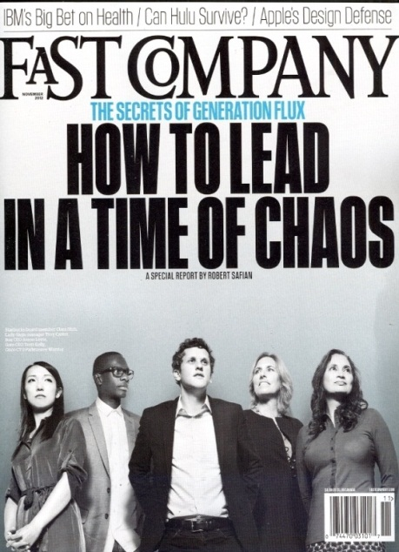
What has the last decade been like?
What one simple phrase would best describe the business environment that we’ve been enduring over the last decade?
Perpetual crisis

Slide 6
This turbulent environment has a name… V.U.C.A.
V for Volatility – major change will be frequent and sudden
U for Uncertainty – there will be many surprises and change will not follow a predictable pattern
C for Complexity – problems & opportunities will be complex… with many different elements
A for Ambiguity – confusion from contradictory information / data will make mis-reads likely
An “adaptive” firm and HR function are needed in a VUCA world

Slide 7
2 quotes that describe this new business world
Big is no longer an advantage
It’s no longer the big established firms that dominate the small ones… it’s the fast, innovative and adaptive firms that now dominate the slower firms
Speed is essential
If the speed of change outside your organization exceeds the speed of change inside your organization, black clouds are ahead and unfortunately… insiders will probably be the last to actually see the disaster coming (Kodak)
Dr John Sullivan

Slide 8
The labor market and “the work” are changing
Knowledge, tech and design work will dominate and… most work will be done in a project format
Innovation will surpass productivity in importance
There will be a permanent skill shortage
That shortage will shift the power in the employee /employer relationship to top talent (be talent centric)
Employee expectations are changing (loyalty, influence, freedom, transparency)

Slide 9
Section II
The benchmark firms that already reflect the future of HR

Slide 10
Benchmark firms
Some firms already have HR functions that act similar to how all future leading functions will
Google
Apple
Facebook
Yahoo
Zappos
Amazon

Slide 11
Section III
12+ Strategic talent principles that will guide the future of HR

Slide 12
Items that HR should add to it’s planning list for 2016
Strategic HR Principle #1
HR must be adaptive…
to meet the VUCA world… and the changing nature of work

Slide 13
Adaptability / agility will also be required in HR
A flexible HR approach is required – your HR strategy/programs must be “scalable” and be able to “shift” to meet changes in the business environment
A flexible workforce – sudden bus. shifts and project work require a larger % of well managed contingent labor
Be prepared to add talent capabilities – HR must be able to add talent capabilities in one business unit or region… while simultaneously reducing labor costs in another
Rapid internal redeployment – you must have the capability for rapidly and proactively moving employees and teams to the most urgent bus. areas

Slide 14
Items that HR should add to it’s planning list for 2016
Strategic HR Principle #2
A focus on increasing
Business Impacts of HR
Workforce productivity
Innovation

Slide 15
Almost everyone agrees that HR must become more strategic
When CEO’s and board-level executives rank business functions… which one is listed as the most strategic?
Sales
Where was HR ranked on the list?
“the least strategic function” Source: DDI
15

Slide 16
HR must measurably increases its business impact
HR must identify/ focus on what senior managers care about? (Strategic business goals and their bonus criteria)
HR must convert it’s results into “the language of business”… which are $ and numbers
Prioritize revenue generation, high impact and innovation jobs, employees, managers and SBU’s
HR must shift its budget and it’s top HR talent to high-impact… functions and programs >

Slide 17
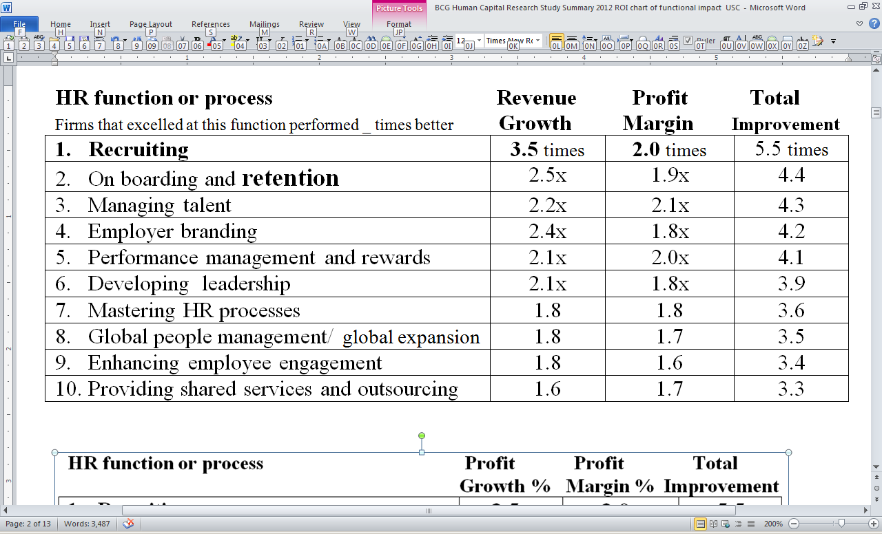
HR must identify and focuses its resources on activities that increase revenue & profit (BCG)
Which HR functions have the highest impact on rev. /profit?
Source: BCG/WFPMA - From Capability to Profitability: Realizing the Value of People Management, 2012

Slide 18
Workforce productivity is… the value produced by labor minus its costs
Develop processes to increase productivity
ID the barriers to productivity (why can’t you produce 25% more?)
Hire / retainself-motivated employees
What motivates / excites each employee
How do the best employees learn
How to best manage me
Distributed ranked metrics to increase competition
Measure and reward managers and employees for productivity
Manage the 20 factors that impact productivity >

Slide 19
To increase productivity… you must effectively manage each of the 20 productivity factors
A great manager
Effective plans & strategies
Clear and prioritized goals /activities to focus the work
Rapid learning / sharing
Right rewards & engagement
The right employee skills
2 way communications
Performance metrics
Quality team members from great hiring/ retention
Collaboration for innovation
“Right job” placement
Processes are integrated
Information for decisions
The right tools/technology
Quality inputs/materials
Enough budget/ resources
The work environment is designed for productivity
Time devoted to the task
ID & removing barriers to productivity/innovation
Outside of work factors

Slide 20
How HR can increase workforce innovation
Increase serendipitous interactions among non-teammates to increase collaboration (physical space)
Fund risky approaches over sure things
Offer free time to experiment (i.e. 20% time)
Use stretch goals and frequent project rotations
Fast approvals for new ideas
Require learning after a failure (failure analysis)
Recognize/reward risk-taking and innovation
Hire and retain innovators
Add a meeting day “for makers”

Slide 21
Items that HR should add to it’s planning list for 2016
Strategic HR Principle #3
HR will shift to a data-driven model that uses predictive metrics to become “forward looking”

Slide 22
Almost everyone agrees that HR doesn’t use many analytics – so there is room for improvement
Where does HR rank in analytics usage compared to other bus functions?
% of advanced users % of non-user
Finance 58% 7%
Executive team 51% 11%
Operations 48% 9%
R&D 44% 23%
Marketing 41% 16%
Sales 34% 20%
HR (last) 27% 23%
Source: AMA/i4cp 2013

Slide 23
An example Google the world’s only data driven HR function
“All people decisions at Google are based on data and analytics”
We want to… “bring the same level of rigor to people-decisions that we do to engineering decisions"
Their People & Innovation Lab (PiLab) runs dozens of experiments on employees in an effort to answer questions about the best way to manage at a large firm (good managers, onboarding, maintaining excitement after long tenure)

Slide 24
Strategic and predictive metrics will emerge
Deemphasize historical (yesterday) metrics
Managers must have “real time data” on their phones, so they know what’s happening today
Forward looking predictive metrics… give mgrs. JIT alerts… so they can mitigate upcoming issues
#1 HR metric - Ratio of ¢’s of profit generated per dollar spent on labor (or revenue per employee)
HR must calculate the $ value of a top performer and the costs of weak performers and managers
HR’s impact must be noted in the annual report
Predictive metrics in these areas… who will quit, hiring factors that predict success, career trajectory etc.

Slide 25
Items that HR should add to it’s planning list for 2016
Strategic HR Principle #4
HR must shift to a proactive internal consulting firm model

Slide 26
Shift to a consulting model
HR begin acting like an internal consulting firm
Why shift – the transactional and compliance focused model unfortunately produces minimal business impacts
Executives trust external management consulting firms to be more effective (McKenzie, BCG etc.)
Unfortunately the current consulting skill levels within HR are unfortunately weak (Only 1/3 of the HR team at Google has an HR background)

Slide 27
HR acts like an internal consulting firm
The people productivity consulting group must…
Focus on increasing productivity & innovation
Ensure that everything in people management reinforces a performance culture
Identify strategic people management problems
Proactively propose opportunities
Focus on finding and fixing weak managers
Borrow from business functions – to increase speed and success rates, HR must borrow best practices from other functions and adapt them to HR (i.e. supply chain, CRM, social media & self-service)

Slide 28
Items that HR should add to it’s planning list for 2016
Strategic HR Principle #5
Managers will do most HR work

Slide 29
“Who” actually does HR must change
Managers will do most HR work at higher quality
HR problems must be solved locally because they are close to the problem and “ownership” forces them to take these problems more seriously
HR problems must be solved fast because of the speed of business (mass personalization)
Real-time data allows managers to make their own data-driven decisions
The mobile phone will allow them to view all HR information and data
Predictive metrics will alert managers about upcoming problems
Algorithms will tell managers the most effective actions an example >

Slide 30
An example of a data-driven approach
1 email results in a 25% improvement in productivity
Each new hire’s manager is sent a JIT on-boarding email… reminding them to do these 5 things
Have a discussion on their role and responsibilities
Match your new hire with a peer buddy
Help your new hire build a social network
Set up onboarding check-ins once a month for their first six months on the job
Encourage an open dialogue
Result – time to minimum productive is 25% faster
Source: Laszlo Bock –

Slide 31
Items that HR should add to it’s planning list for 2016
Strategic HR Principle #6
Planned obsolescence must be implemented in all
areas of HR

Slide 32
Assume obsolescence in a fast-changing world
Hire people that see the glass as half empty & leaking
New HR approaches must include an obsolescence date and a “next practice” replacement
Skills obsolescence – HR must forecast employee skill obsolescence (i.e. use by date)

Slide 33
Items that HR should add to it’s planning list for 2016
Strategic HR Principle #7
HR must match the speed
maintained by the rest of the organization

Slide 34
Ways that HR can increase organizational speed
Hire people that are fast – give them a process and ask them how they would expedite it
Train for speed – identify, share and teach speed techniques (i.e. nonlinear thinking)
Decision-making speed – increasing collaboration and integrating processes improves decision speed
Hire fast – 1 day hiring (with pre-assessment), limit interviews, sandwich board referrals & talent pools
Release faster – use algorithms to forecast slowing performers and new hires
80% decisions – can increase decision speed
Track approvals – to see if they really help

Slide 35
Items that HR should add to it’s planning list for 2016
Strategic HR Principle #8
Rapid learning is required throughout the organization

Slide 36
Learning ability is the #1 competency
“… learning ability is the key determiner in deciding among candidates” (with their technical capabilities)
Laszlo Bock VP of HR

Slide 37
HR increases learning
Measure learning speed – measure firm, dept. & individual employee learning speed
Organizational learning at all levels – not top-down, but learning at all organizational levels
Informal learning – HR must shift to “employee ownership” and self-directed informal learning
Sharing how the best learn – share your top performer’s top learning approaches and sites
Spreading best practices – rapid best practice identification and sharing has a high ROI
Make learning a criteria – learning must be a hiring, perf. appraisal & promotion criteria

Slide 38
Items that HR should add to it’s planning list for 2016
Strategic HR Principle #9
HR must provide a competitive advantage

Slide 39
A competitive advantage is needed
Execs expect a functional competitive advantage
ID talent competitors – identify the firms in your region and industry that attract your target talent
Competitive analysis – monitor your talent competitors and match their TM improvements
Goal… your HR results and processes must stay measurably better than your talent competitors
Take advantage of competitor problems – proactively act when talent competitors are undergoing major problems (M&A, layoffs, hiring freezes, scandals or turnover)

Slide 40
Items that HR should add to it’s planning list for 2016
Strategic HR Principle #10
HR must be globalized… with mass personalization… so “one size fits one”

Slide 41
In a global bus. world, HR must also be global
Global business - HR has no choice but to mirror global business capabilities in all talent functions
One-size-fits-all doesn’t work – the most effective HR approaches are “mass personalized” to fit the region, the business unit’s goals and the local managers and employees
Technology advances - will allow for more remote work… so the talent pool will be global and the work must shift to “where the talent is”
Global diversity to reflect our customers – you must hire, retain and manage a workforce that understands the needs of your global customers
41

Slide 42
Items that HR should add to it’s planning list for 2016
Strategic HR Principle #11
The different HR functions must become fully integrated

Slide 43
Today’s HR is highly compartmentalized
HR is now compartmentalized with silos
Managers expect one-stop answers to their problems and an enterprise mentality (big picture)
Unfortunately managers currently must “shop for answers” and beforehand know exactly what they need and which HR function has jurisdiction
HR should measure the time from the “problem to the solution” and identify handoff issues
Cross-training and cross-department rotations can improve coordination
Shared metrics / rewards can improve integration

Slide 44
Items that HR should add to it’s planning list for 2016
Strategic HR Principle #12
HR must recommend both human and technology solutions for new work

Slide 45
Technology and people can both do work
Traditionally HR 100% of the time recommends using people to do work…
Software and hardware technologies can now replace “work” done by people (ex. Call centers versus IVR)
HR must use data to analyze work and neutrally recommend whether employees, contingent workers, outsourcers or technology should do it
Software
Robotics
Phone apps
Drones

Slide 46
5 additional principles that define HR’s future
One hell of a business case will be required – Executives will remain cynical of HR until we convert HR results into their $’s of revenue impact
More strategic less transactional – HR must focus on strategic problems and opportunities and shift away from transactional areas and efficiency
More risk – HR must measure risks and accept a higher risk profile (but with a higher payback)
HR relies on technology – HR must rely on tech, the internet, Social Media and the mobile phone for speed, low cost and global capability
A smaller HR – HR must learn to operate with fewer core HR staff and reduced budget levels as a result of technology and lower funding levels
46

Slide 47
Section IV
I will briefly go over…
Changes that must be made in key HR functions

Slide 48
Individual HR functions must change
Recruiting must change

Slide 49
The future of recruiting
Algorithms/ bots to find top talent / innovators
Matching software to match a person with a job
Aggressiveness has become the norm
Direct sourcing of “not looking prospects” (80%)
Referrals reach 50%
Prioritizing jobs based on business impact
Direct poaching from competitors
Contests to attract “not looking prospects”
Online assessment
Selling prospects and candidates is critical

Slide 50
Individual HR functions must change
The leadership development function must change

Slide 51
Leadership development
Everyone may be a leader – project-based work will require numerous leaders
Forget predicting leaders / HiPo's – in a changing world, focus on current performance
Develop the whole team together – the leader must be developed together with their team
Develop them fast – accelerated leadership development must be completed within six months
Use virtual projects – most development will be by a series of short term virtual projects
Managers are rewarded – managers must be measured and rewarded for developing and eventually releasing developed talent

Slide 52
Individual HR functions must change
HRMS must change

Slide 53
HRMS key features
The cloud – so that HR information is available to users at any time from any place, using any device
Push customized information – customized information and data must be "pushed" just-in-time to individual team leaders and managers
Systems that learn - many current HRMS systems are "dumb", so feedback loops must be introduced so that HR can learn from its previous errors
Merge with IT - over time, the need for an autonomous HRMS unit may wane

Slide 54
Individual HR functions must change
The retention function
must change

Slide 55
Employee retention
4 retention focus areas
Retention efforts must be targeted – there must be a focus on key and high impact employees and “regrettable” turnover
Metric driven – metric algorithms will help to predict who is likely to leave and what factors would cause employees to leave or to stay
Customize approaches – retention plans must be customized to job families or even individuals, based on their reasons for wanting to leave
Managers must be held accountable - the cost of turnover will be calculated and managers must be held accountable for losing key employees

Slide 56
Individual HR functions must change
The compensation and benefits function must change

Slide 57
Compensation and benefits
Rewards for people management - metrics, rewards and recognition will excite managers and increase the time they spend on people issues
Pay for performance – bonuses for short-term and long-term performance, as well as bus. impacts
Team motivators - motivators for the entire team in order to increase productivity and innovation
Non-monetary motivation - nearly half of what motivates employees is not related to money
Paying those without a fixed job - because of project-based jobs, compensation will be difficult

Slide 58
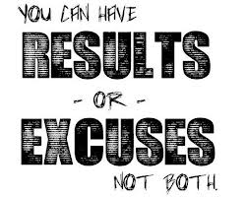
But… But… we are different!
Mobile phones, software, supply chain, finance etc. are not materially different around the world… and neither will HR be
58

Slide 59
Any final questions ?
Did I make you think?
If this projected future of HR is equal to 100 points, how many points would your firm get based on where it is today?
JohnS@sfsu.edu

